Slide 1


FSM-Based Operator Skill Detection
and Adaptive Safety System
Presented by: Mehul J Dhakne
Department: Electronics Engineering

Slide 2
Introduction / Abstract
• This project focuses on evaluating operator skill before allowing machine operation
• Uses FSM (Finite State Machine) for structured control
• Combines procedural validation and behavior analysis
• Provides real-time feedback using LEDs

Slide 3

Need / Motivation
Machines treat all operators equally
• No verification of operator skill
• Unsafe operations due to human errors
• Need for adaptive safety systems
Solution: Behavior-based control system

Slide 4


Problem Statement
• Lack of systems that:
- Validate correct procedure
- Analyze operator behavior
- Adapt system response
• Existing systems are:
- Either too simple
- Or too complex and expensive

Slide 5
System Overview
System has 3 parts:
1. Input:
• Push Buttons
• Potentiometer
2. Processing:
• Arduino + FSM logic
3. Output:
• LEDs (Status Indication)

Slide 6
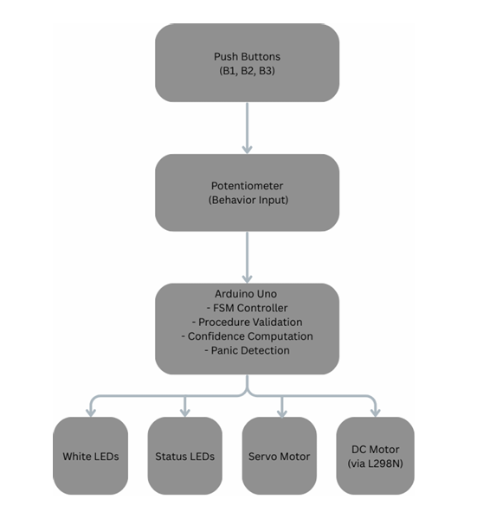
Block Diagram

Slide 7
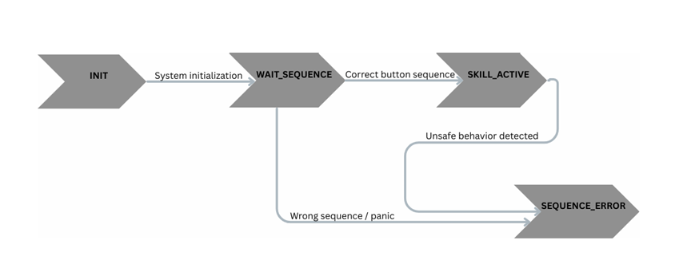
FSM Concept
States used:
• INIT
• WAIT_SEQUENCE
• SKILL_ACTIVE
• ERROR
FSM ensures:
✔ Structured operation
✔ Predictable behavior
✔ Safety control

Slide 8
Universitas Borcelle
Working Principle
Step 1: Operator follows button sequence
Step 2: System validates correctness
Step 3: Potentiometer input is analyzed
Step 4: Confidence level is calculated
Output:
• Green → Skilled
• Yellow → Intermediate
• Red → Error

Slide 9
Universitas Borcelle
Working Principle
Step 1: Operator follows button sequence
Step 2: System validates correctness
Step 3: Potentiometer input is analyzed
Step 4: Confidence level is calculated
Output:
• Green → Skilled
• Yellow → Intermediate
• Red → Error

Slide 10
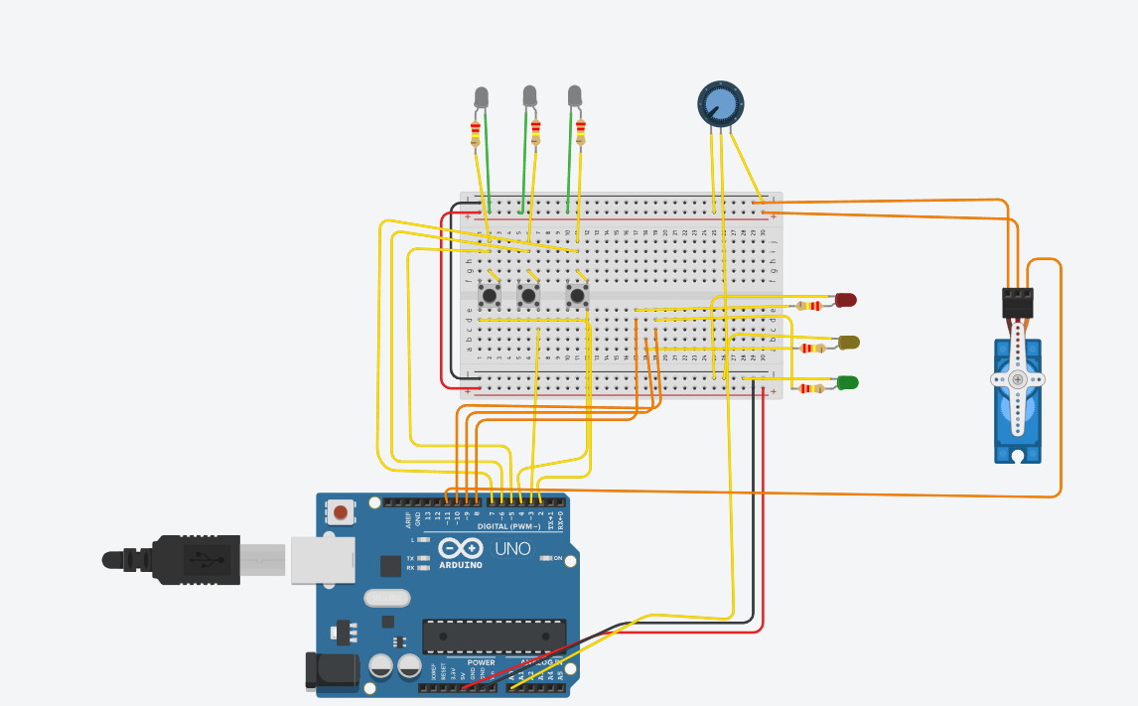
Simulator Output
• Successful sequence → LEDs ON
• Smooth input → Green LED
• Jerky input → Yellow LED
• Error → Red LED

Slide 11
Specifications & Results
Results:
✔ Correct sequence detected
✔ Behavior classified successfully
✔ Panic detected accurately
✔ System responds in real-time
Specifications:
• Arduino Uno
• 3 Push Buttons
• 1 Potentiometer
• 6 LEDs

Slide 12
Conclusion & Future Scope
Conclusion:
• System successfully detects operator skill
• FSM ensures structured and safe operation
• Behavior-based evaluation improves safety
Future Scope:
• Servo motor for safety gate
• Motor speed control
• Data logging system
• AI-based behavior analysis

Slide 13
Thank You

